Slide 1
Randoms Distribution

Slide 2
Covariate | Average
NDVI | 0.49
% mpine | 0.53
% grassy | 0.08
% decid | 0.27
% bf | 0.04
% water | 0.04
Dtn road (m) | 30.4
Dtn mpine (m) | 12.40
Dtn grassy (m) | 238.0
Dtn decid (m) | 28.9
Dtn bf (m) | 84.1
Dtn water (m) | 149.0
Generated 11,331 randomly generated points across the property in a grid
Extracted values for each covariate at each point
Averaged

Slide 3
Property

Slide 4
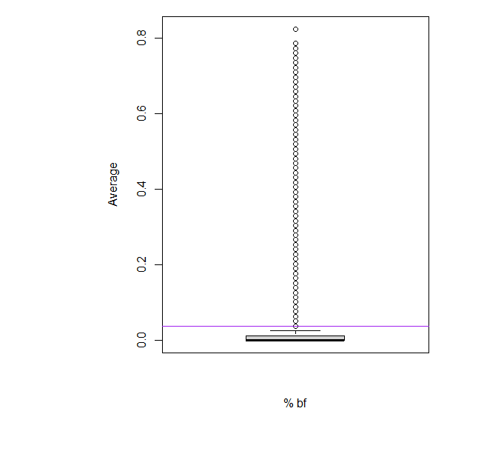
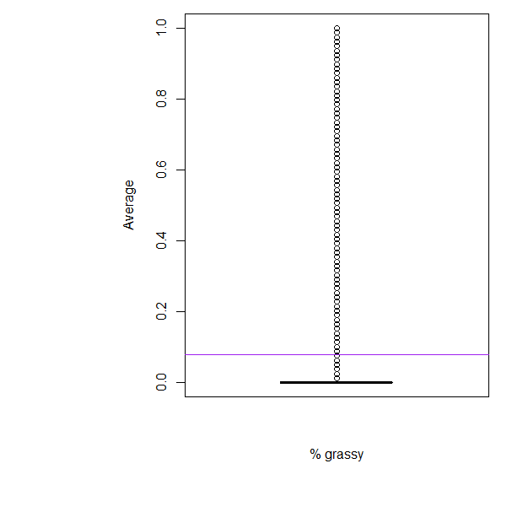
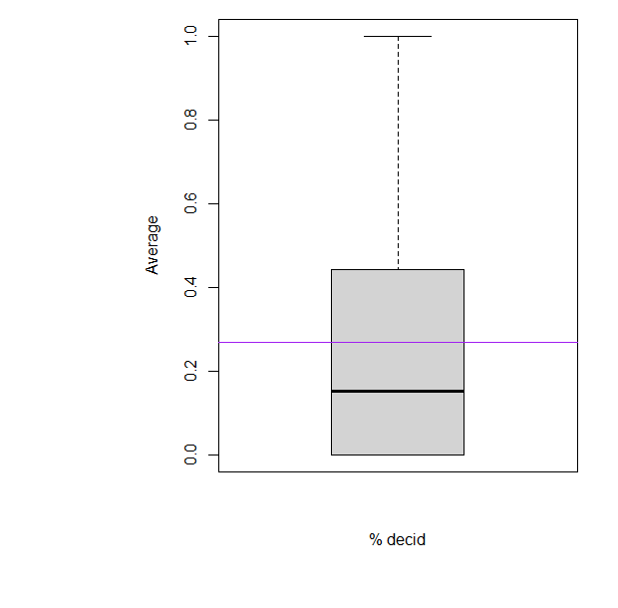
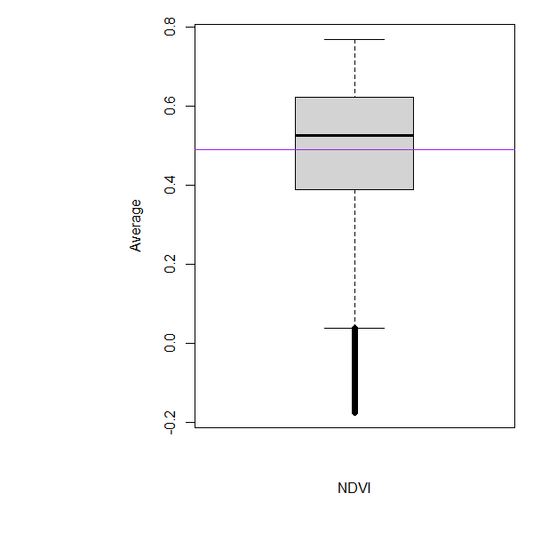
% BF
% Grassy
% Decid
NDVI

Slide 5
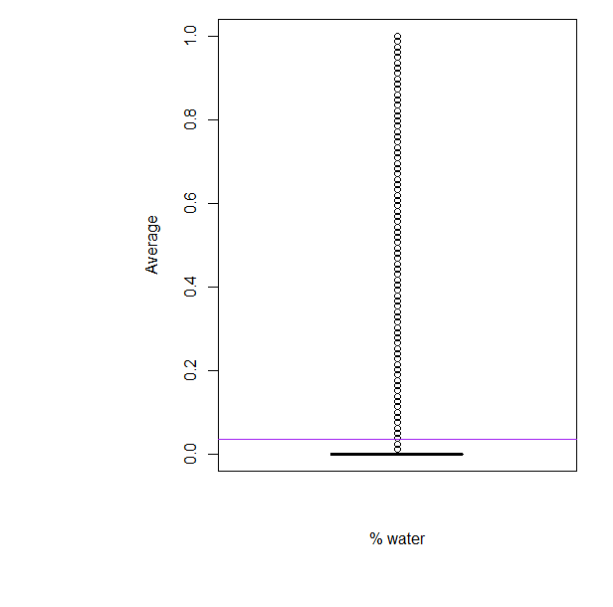
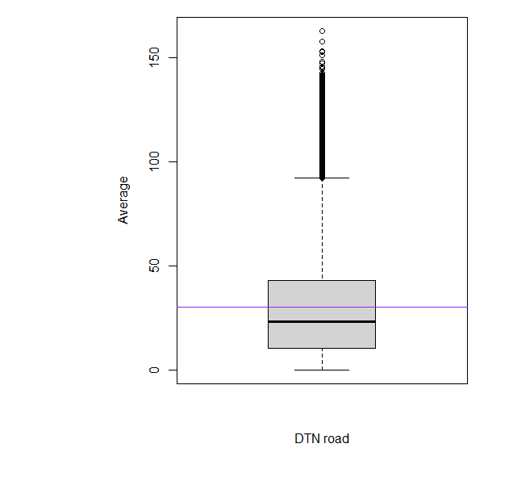
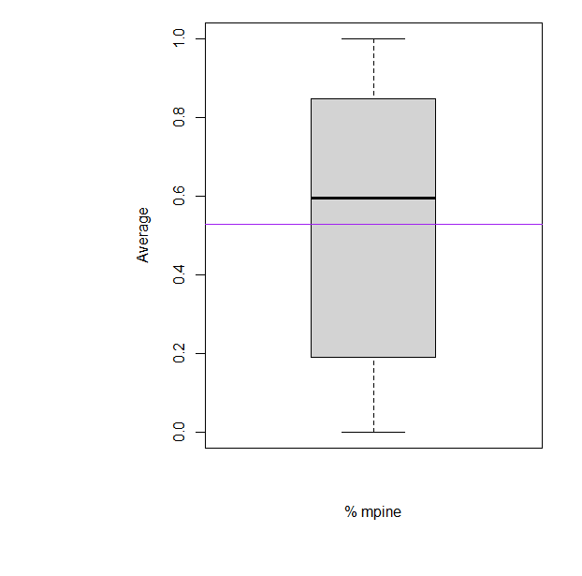
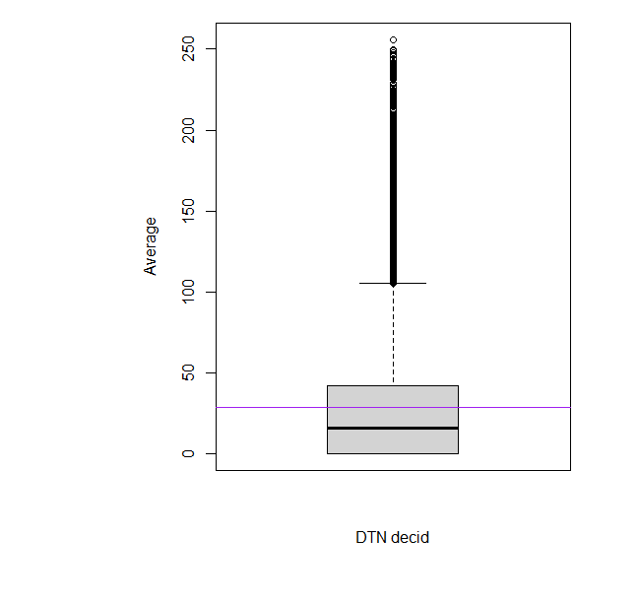
% Water
DTN road
% Mpine
DTN decid

Slide 6
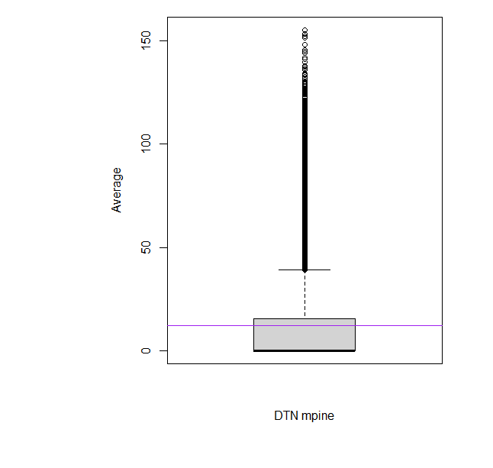
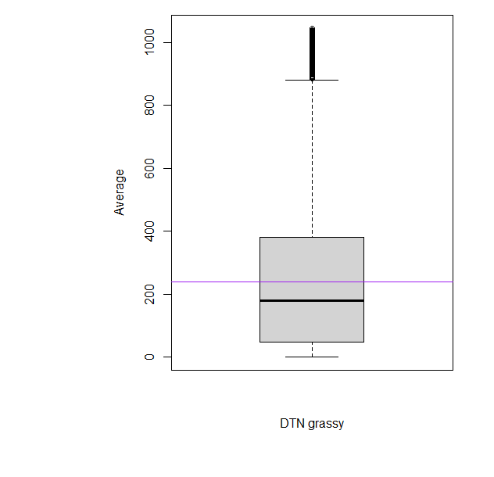
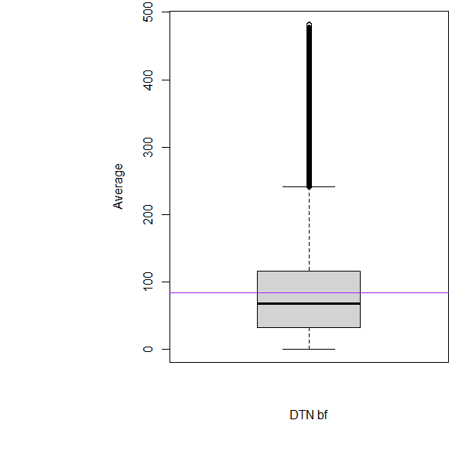
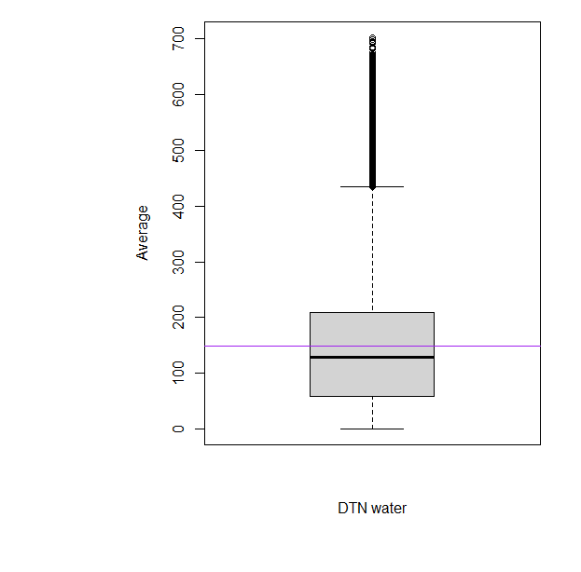
DTN Mpine
DTN Grassy
DTN bf
DTN Water

Slide 7
Course

Slide 8

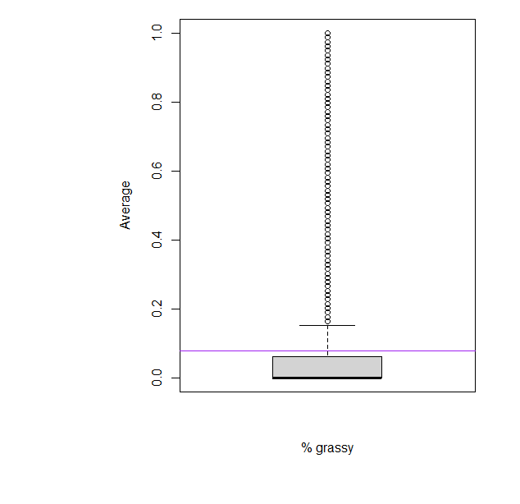
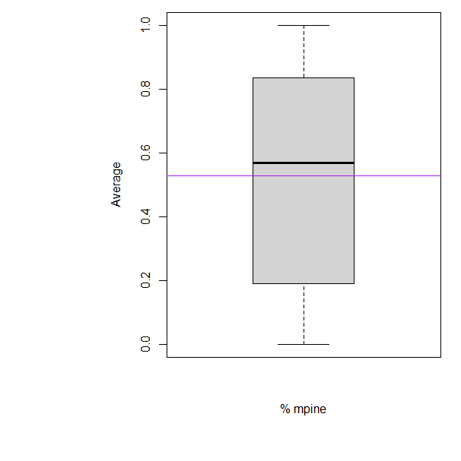
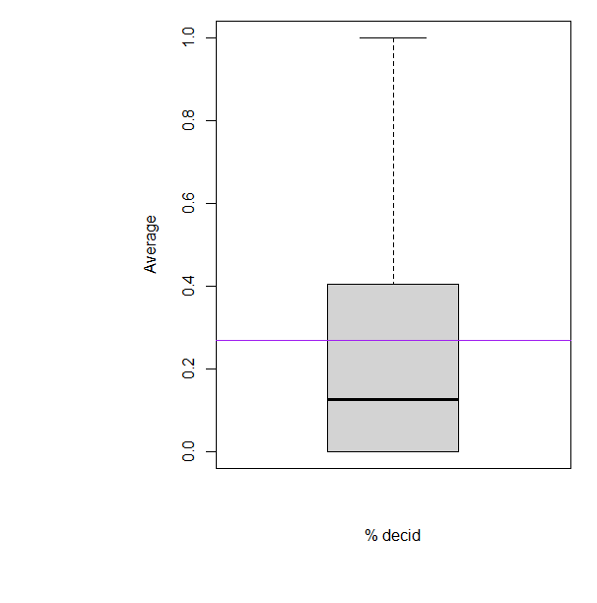
% BF
% Grassy
% Mpine
% Decid

Slide 9
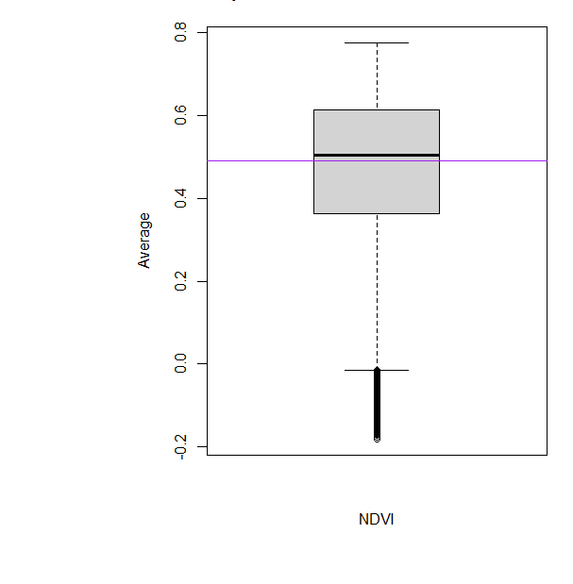
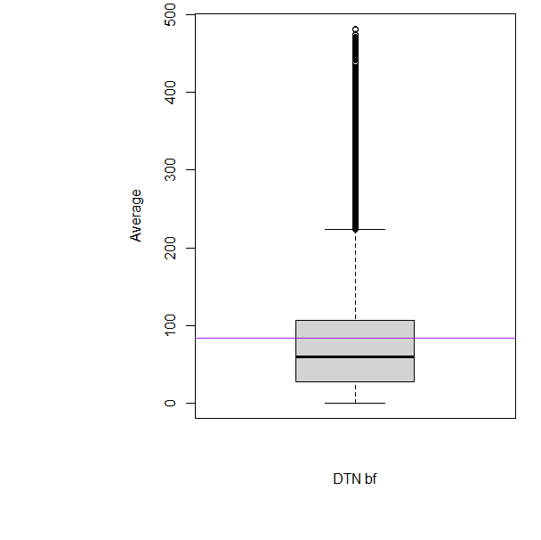
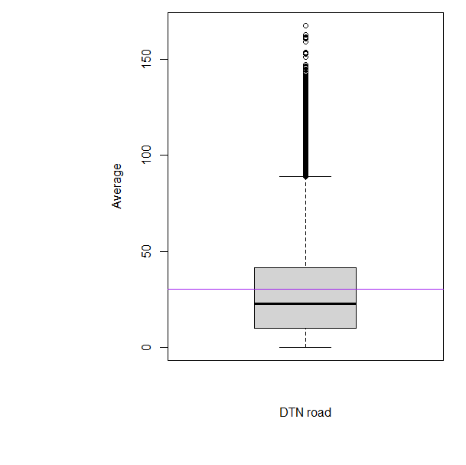

% BF
DTN road
% Water
NDVI

Slide 10
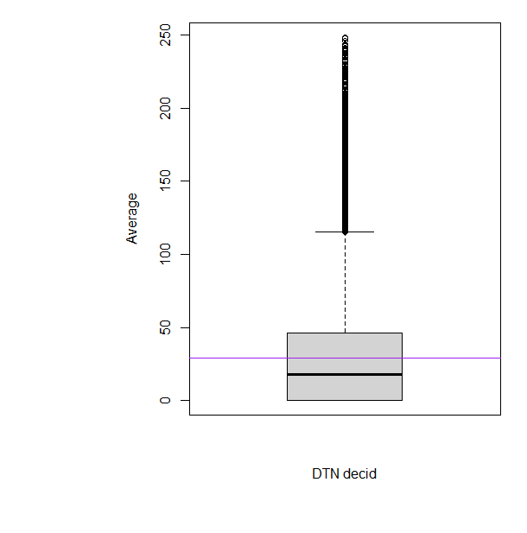
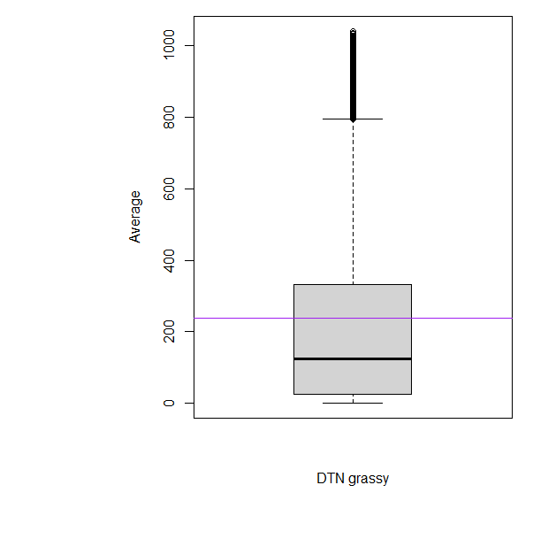
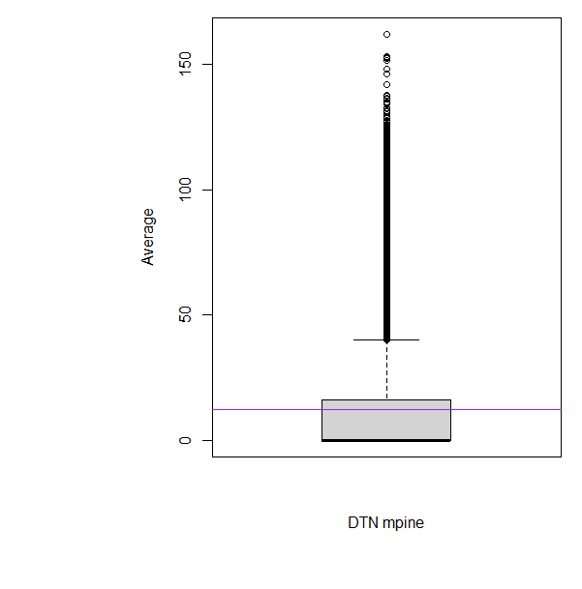

DTN Mpine
DTN water
DTN Decid
DTN Grassy

Slide 11
MCP

Slide 12


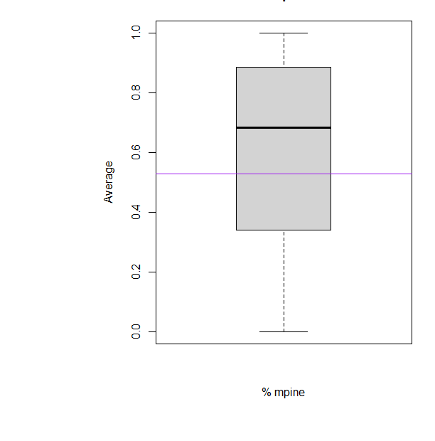
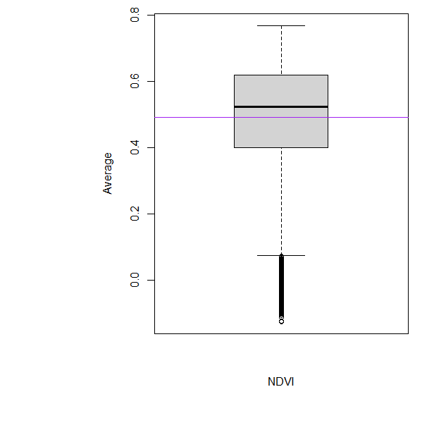
% Decid
% Grassy
% Mpine
NDVI

Slide 13
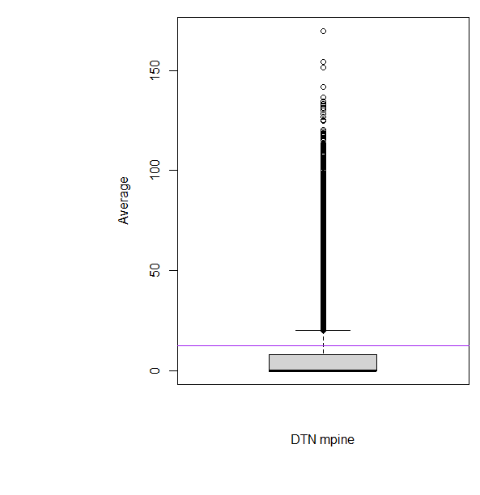
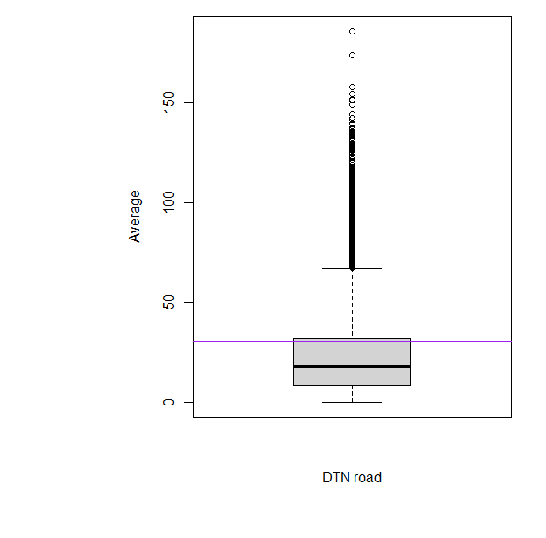
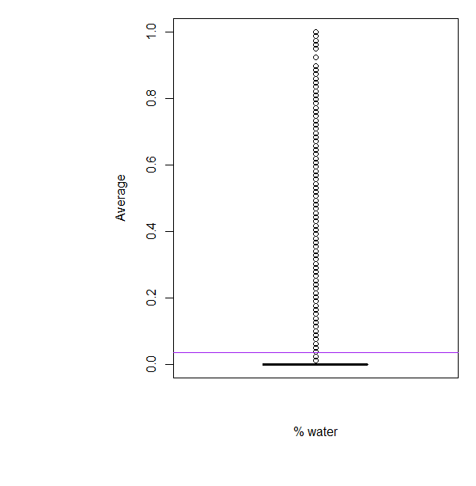
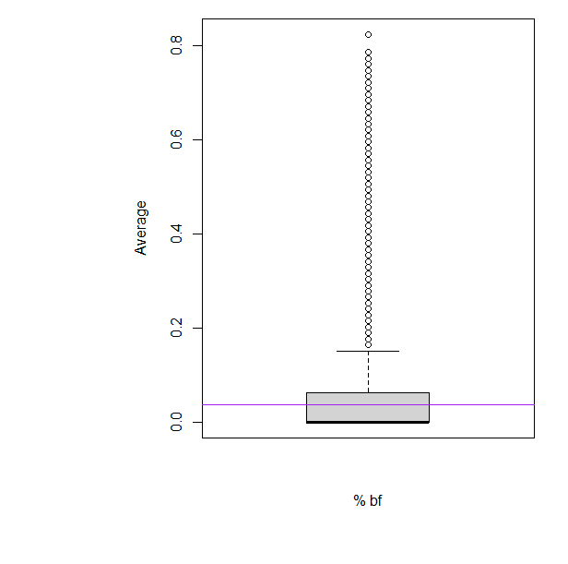
DTN Mpine
DTN road
% Water
% BF

Slide 14

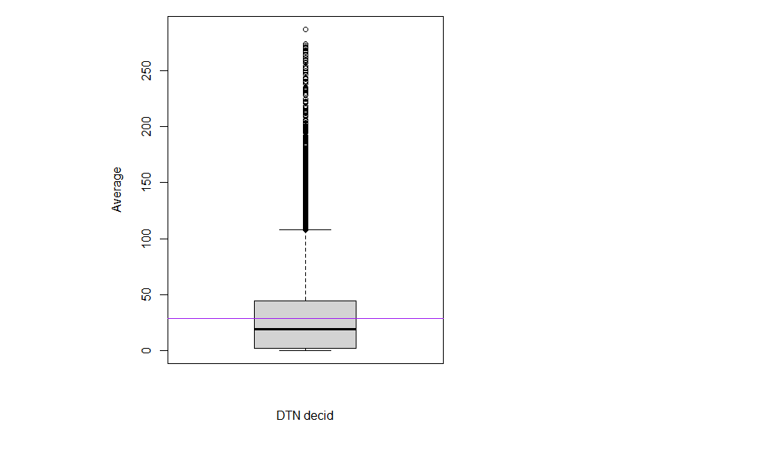

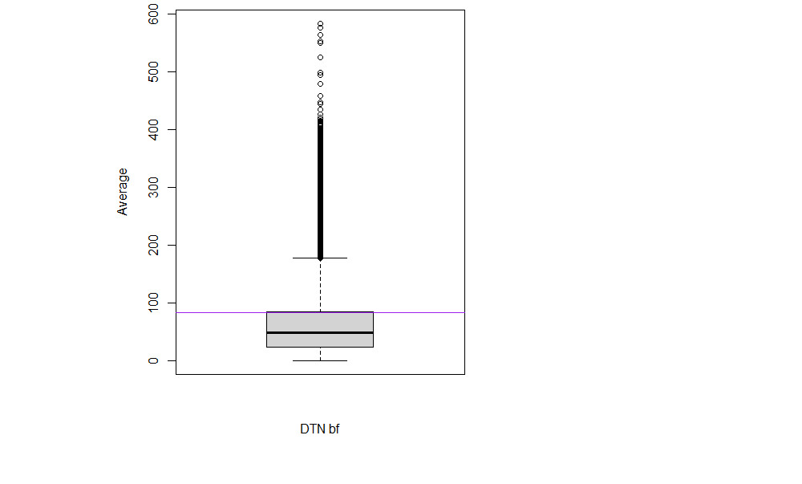
DTN grassy
DTN decid
DTN bf
DTN water

